Slide 1

Offer Mastery
© EASY A MEDIA INC.

Slide 2
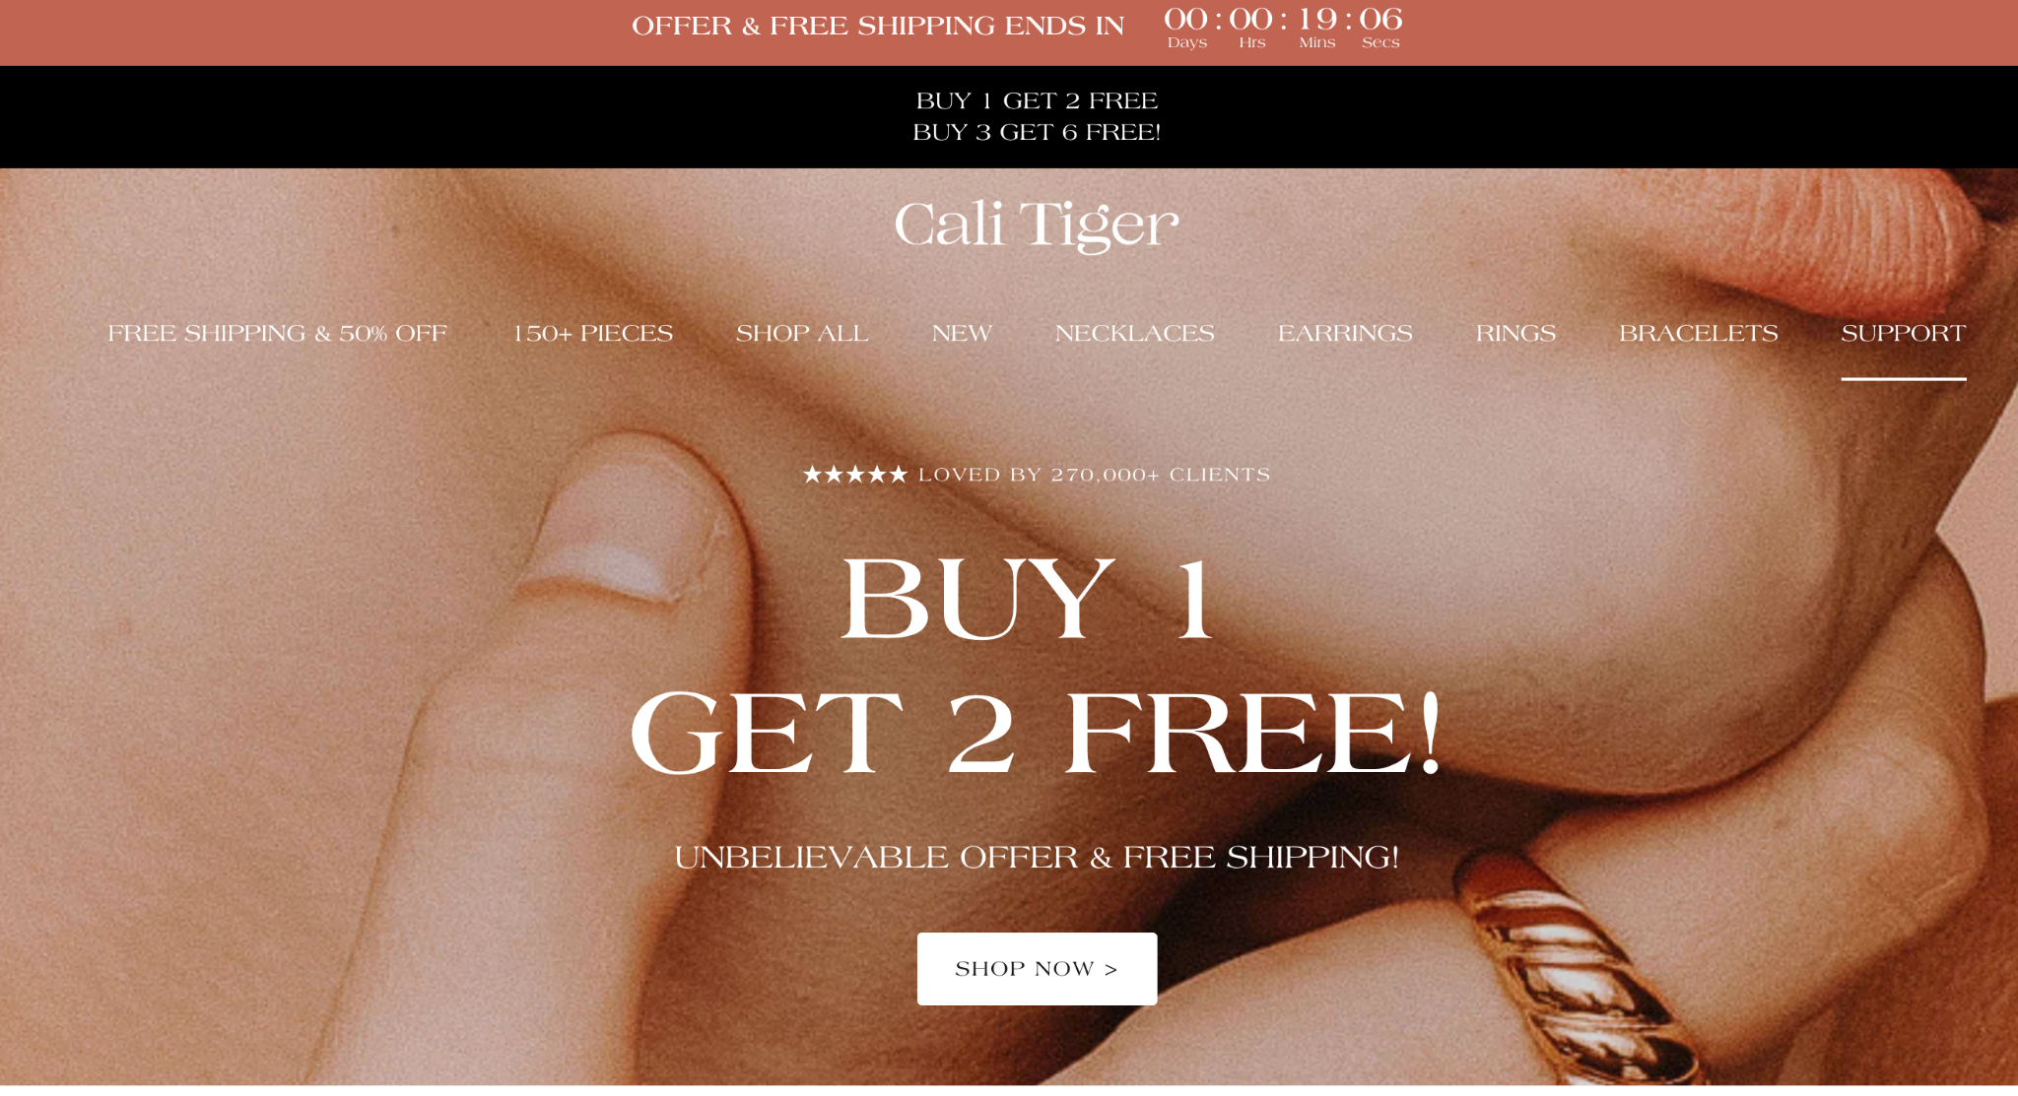
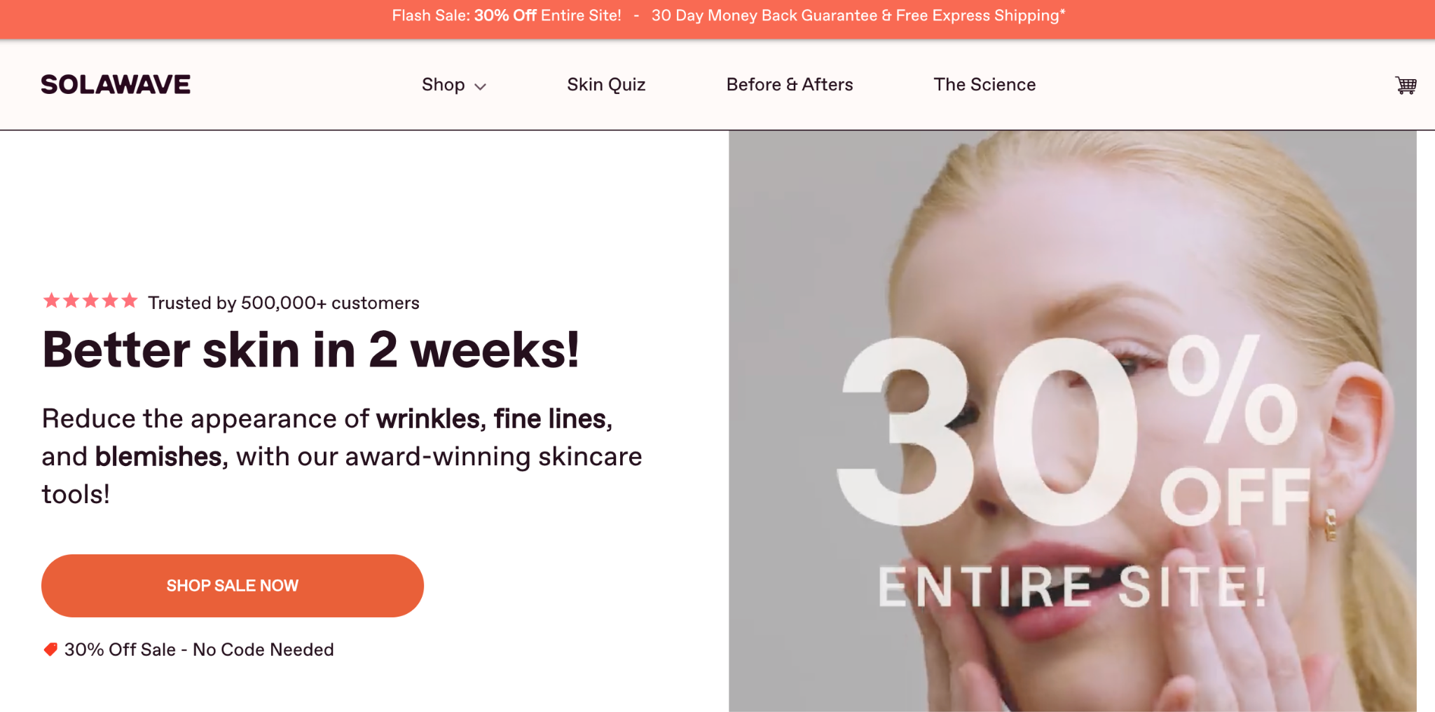

⭐️ IMPORTANT NOTE #1
Offers can be like drugs… They are ADDICTING. They can take your ROAS from a 2x to 4x overnight, pump your conversion rate from a 1.5% to 2.5%, and drive revenue through the roof… But, they can oftentimes be IMPOSSIBLE to get off of and can be OVERLY relied on to acquire customers.
Easy A Media

Slide 3
⭐️ IMPORTANT NOTE #2
Prior to setting up any offer ALWAYS use the profit calculator to establish the new targets for ROAS & CPA so you know whether or not it is successful
Evergreen Example: If your ROAS is currently a 2x and your break even ROAS is 1.43x (70% Gross profit) and your spending $100k per month, and you’re generating $200k total.
Your Gross Profit = $40,000 ($200k rev *0.7 gp = $140k gp - $100k spend)
New Offer Example: But if you launch a 30% offer Keeps you at a 2x ROAS but your breakeven is now 1.82x (55% Gross profit) and now your spending $150k per month, generating $300k total
Gross Profit = $15,000 ($300k rev *0.55 gp = $165k gp - $150k spend) Easy: https://www.easyamedia.com/profit-calculator
Easy A Media

Slide 4
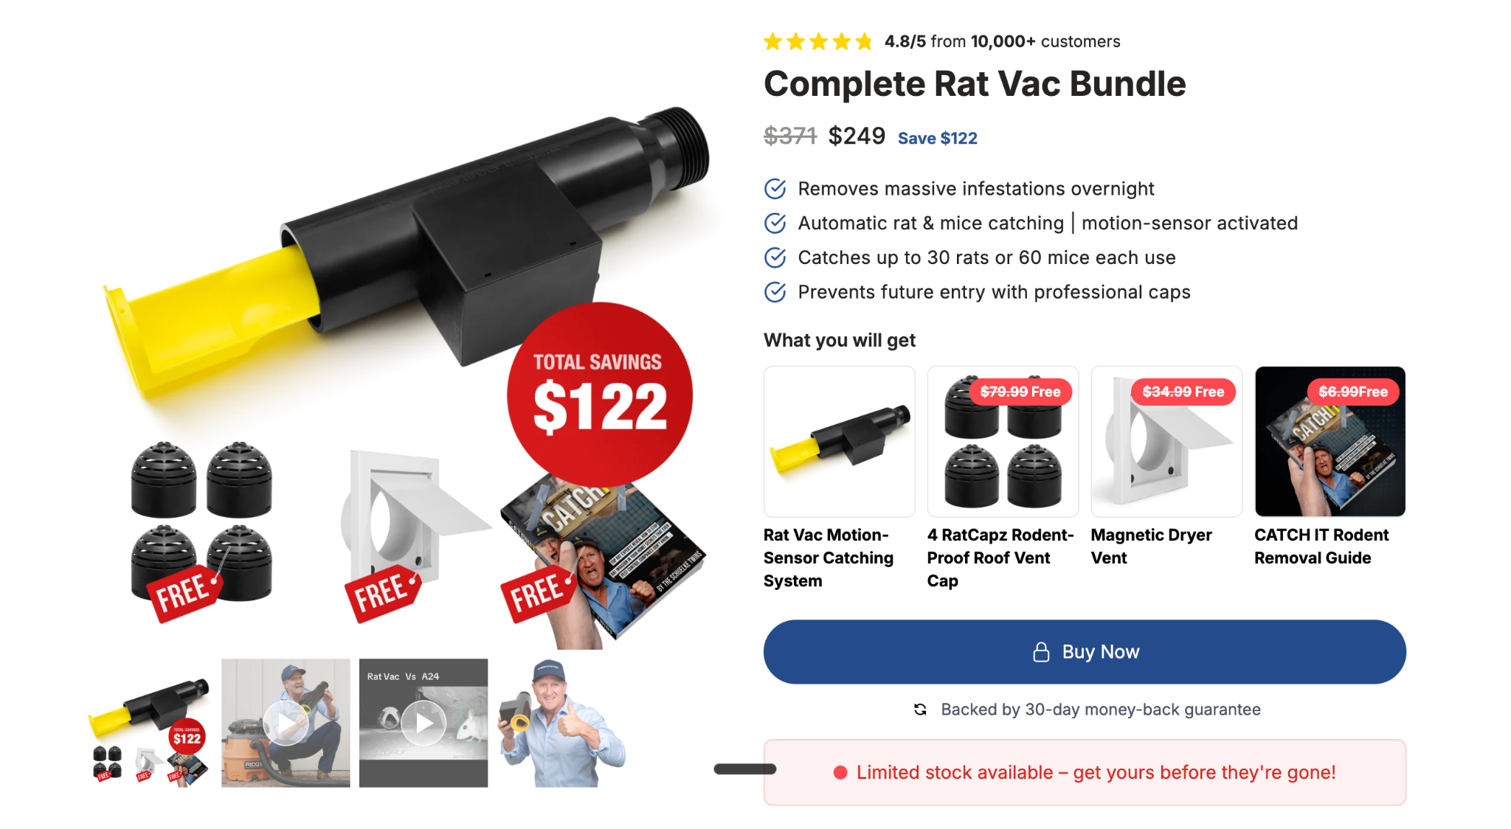
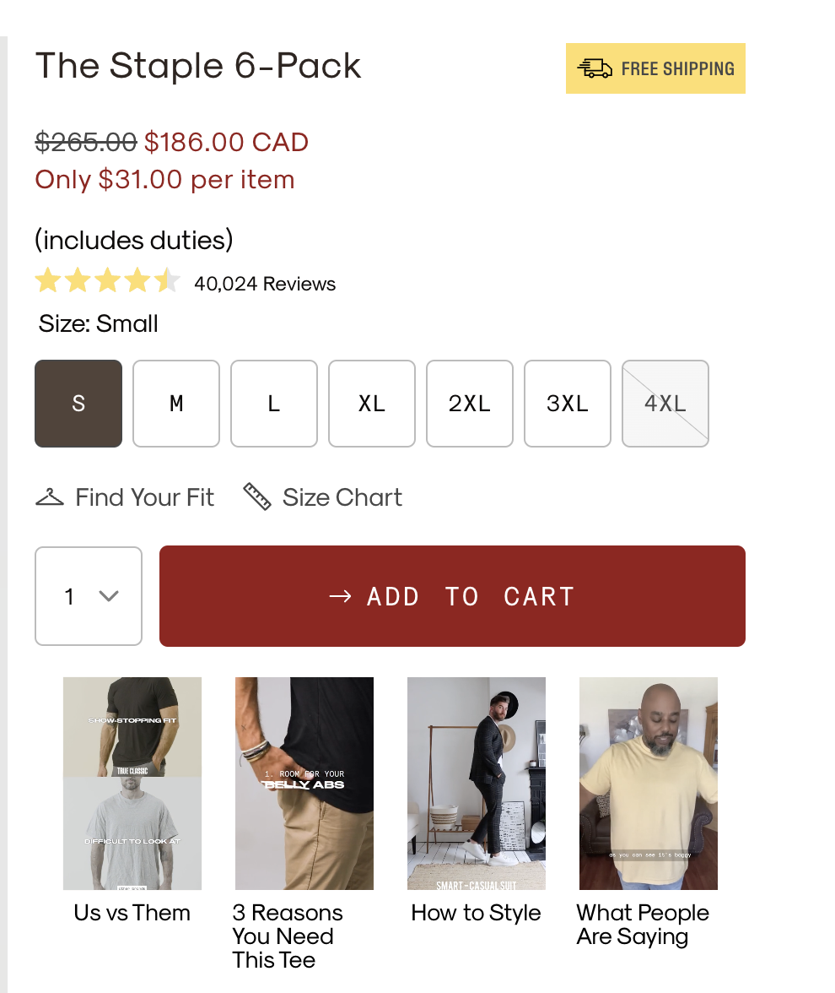
💸Highly Recommend Offer
Bundle & Save
Group commonly purchased products and bundle together at a discount. Provide a REASON for the bundle & think of a name for the bundle as well.
“The Staple 6-Pack” | Regular $265 Now for $186.00
“Rat Protection Bundle” | Rat Vac + Capz + Vent + eBook | Regular $371 now $249
Easy A Media

Slide 5
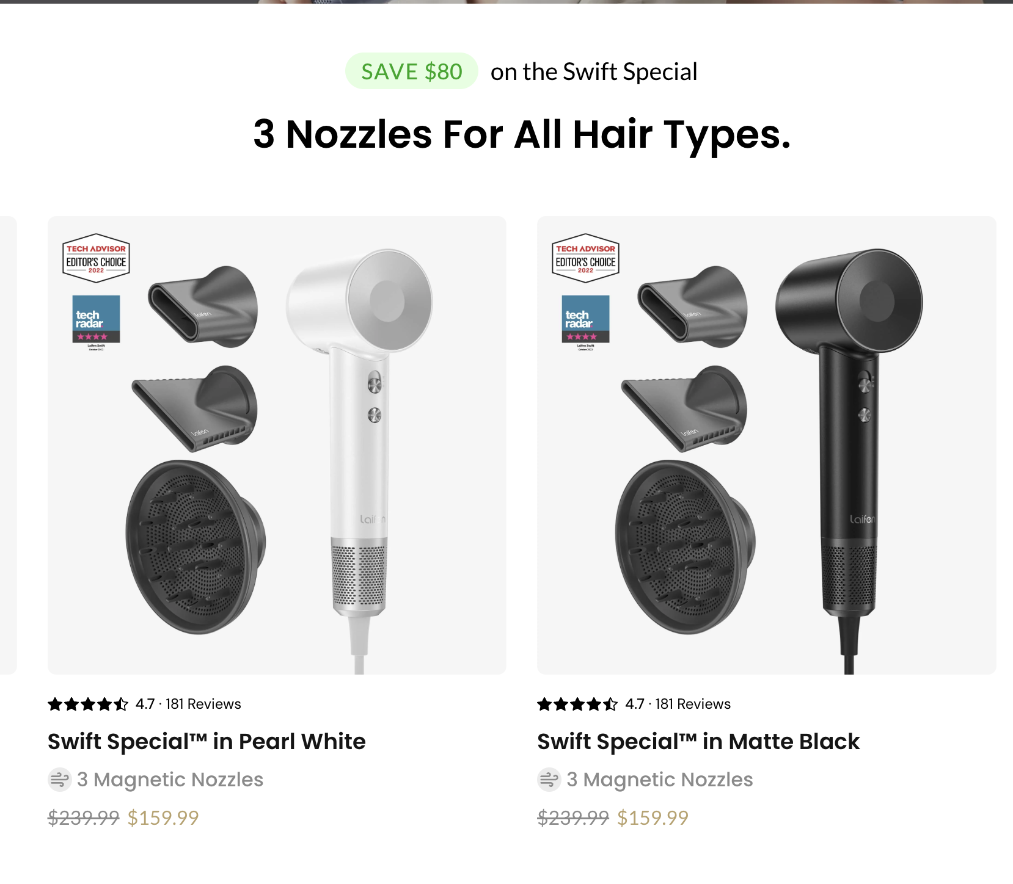
💸Highly Recommend Offer
$X Amount Off
Dollar amount off product or order (Law of large numbers)
“Save $20!”
“Save $30 On First Orders!”
“Save Up To $80! Sitewide” (Discount select products or variants)
Easy A Media

Slide 6

💸Highly Recommend Offer
%X Amount Off
Percentage amount off product or order (Law of large numbers)
“Save 10%”
“Save 25% On First Orders!”
“Save Up To 80% Sitewide” (Discount select products or variants)
Easy A Media

Slide 7
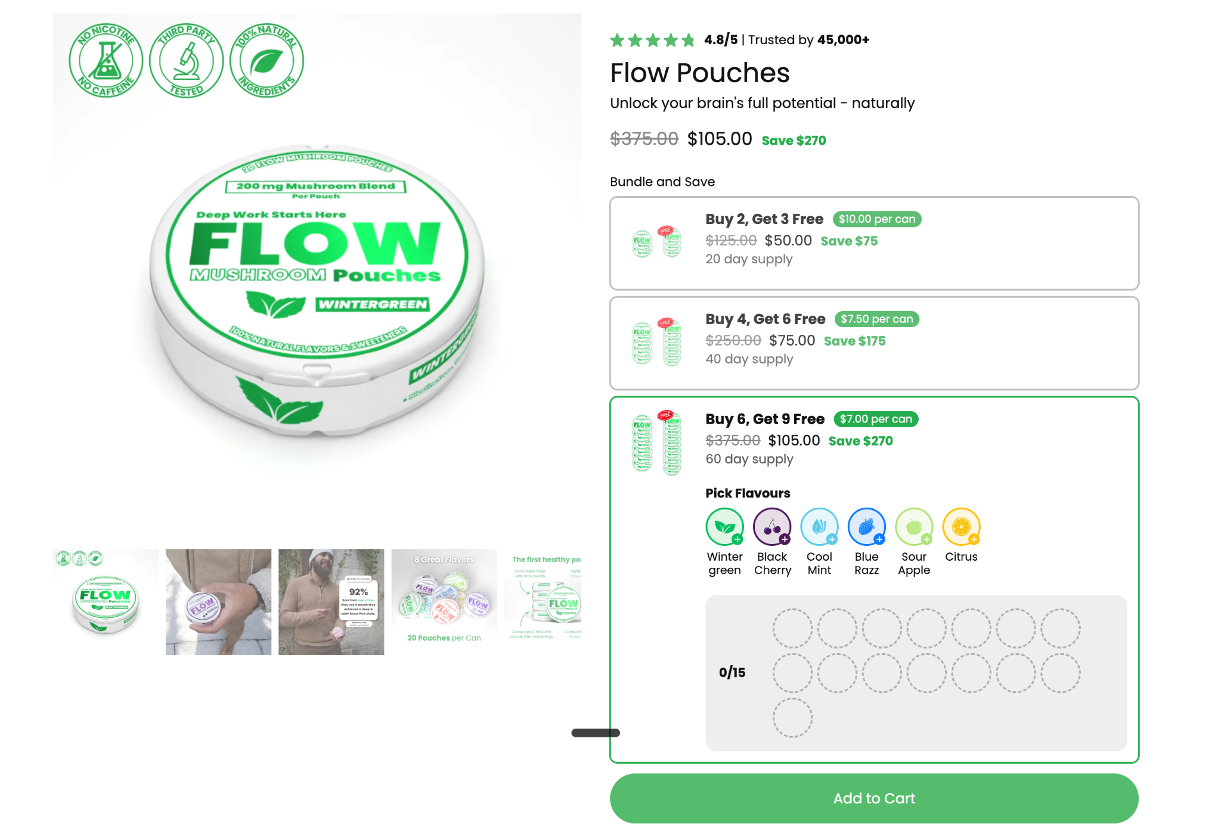
💸Highly Recommend Offer
Buy X Get X Free
Buy a certain number of products and get another one free.
“Buy 1 Get 1 Free”
“Buy 2 Get 1 Free”
“Buy X Get Another Product Free”
Easy A Media

Slide 8

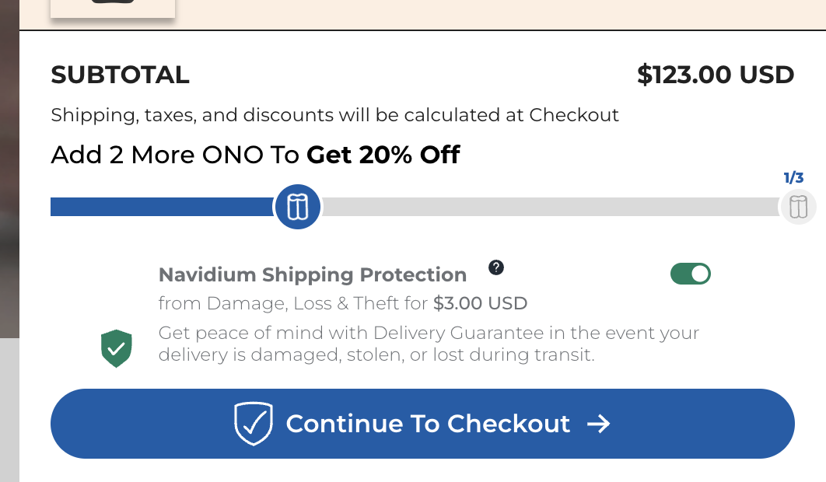
😥Recommend If You Have Bad Margins
Buy X Get X% Off
Buy a certain number of products and get a % off another
“Buy 1 Get 1 50% Off!”
“Buy 1 Get X product 15% Off”
Easy A Media

Slide 9
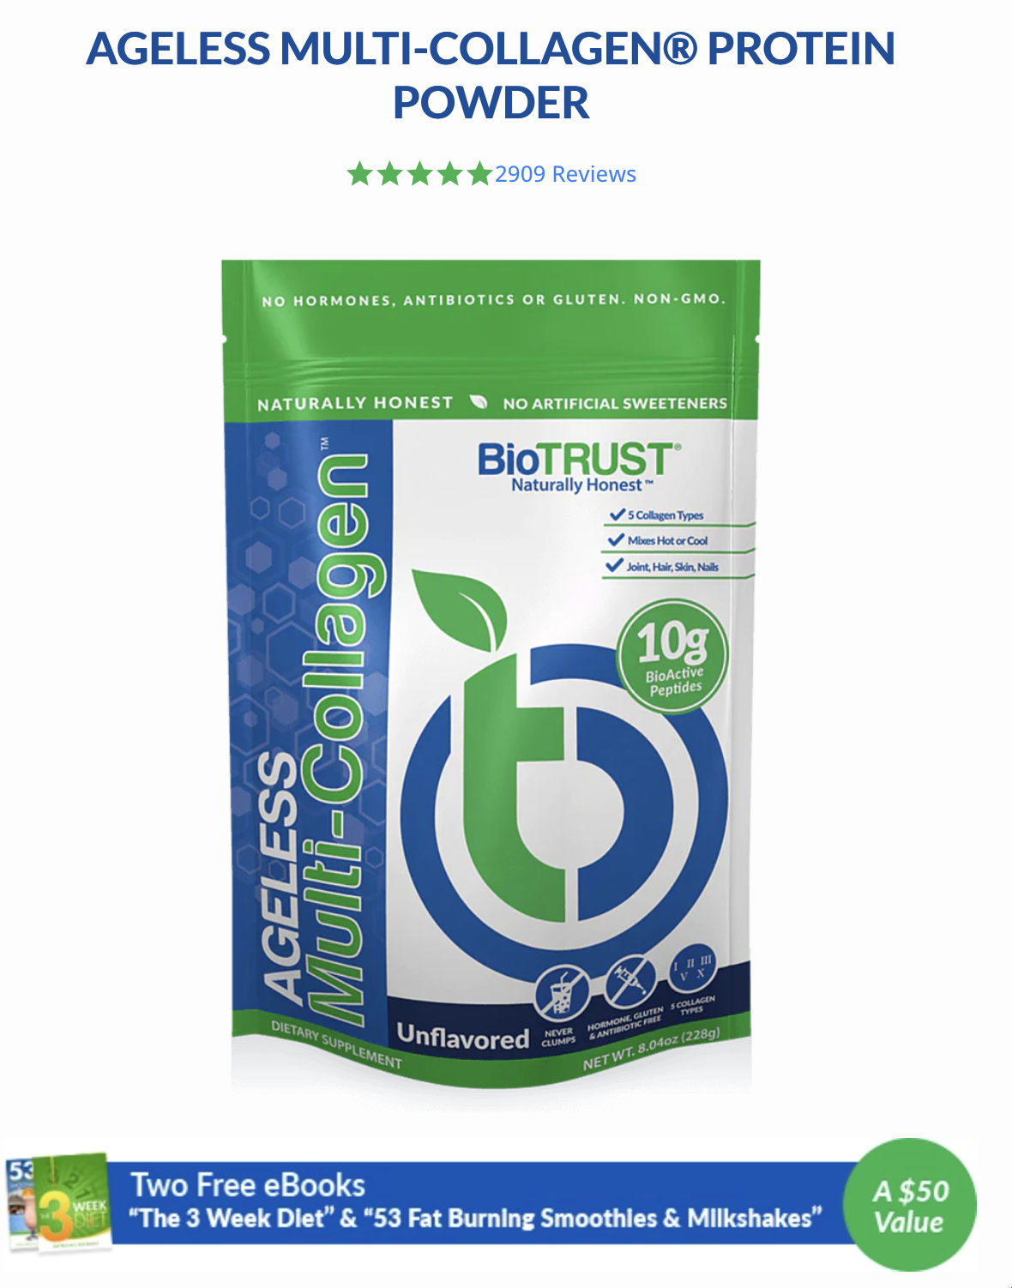
🛒Recommend as an Add-On (not core offer)
Free Gift
When you purchase a product you’ll also get another product
“Free Mystery Gift when you spend X” or "When you purchase X”
Free Complimentary Product (product that goes well with main SKU)
⭐️Free E-Book (That helps the user accomplish the dream outcome)
Free Gift Wrapping (Q4 offer)
Easy A Media

Slide 10
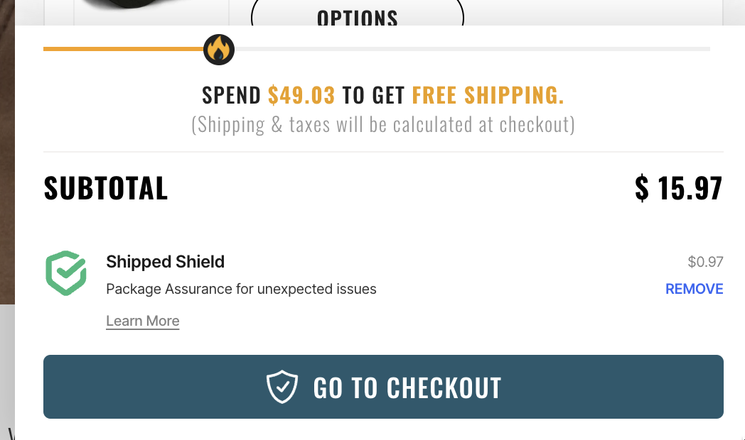
🛒Recommend as an Add-On (not core offer)
Free Shipping
Free shipping on specific product or whole store
“Free Shipping On All Orders”
“Free Shipping On First Orders”
“Free Shipping when you spend X”
“Free Expedited Shipping”
Easy A Media

